Slide 1
R Programming
R Syntax
Variables & Data Types
Data Structures
Basic Operations & Functions

Slide 2
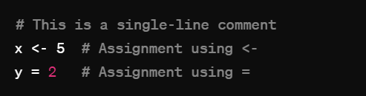
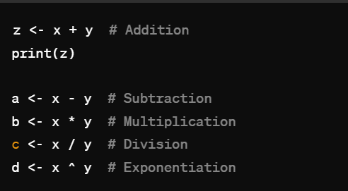
Commenting & assignment

Slide 3

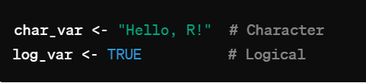
Variables & Data Types

Slide 4
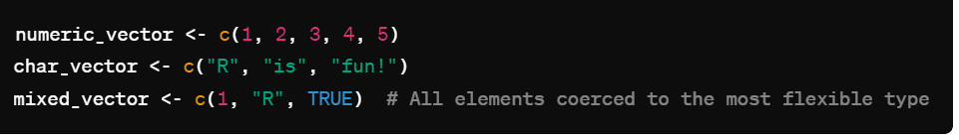
Variables & Data Types
Vector & Type Correction

Slide 5


Data Structures
List
Matrix

Slide 6
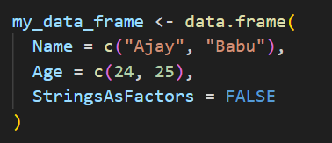
Data Structures
Dataframes

Slide 7
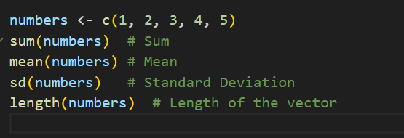
Built-in Functions

Slide 8
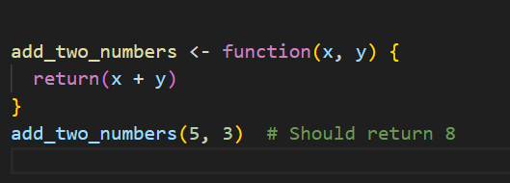
Custom Function

Slide 9
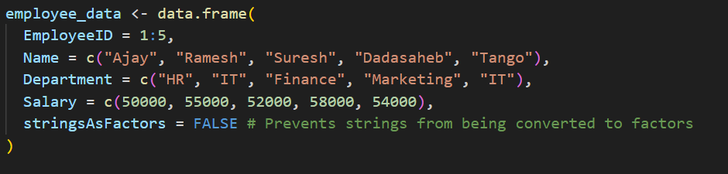
DataFrame Operations

Slide 10
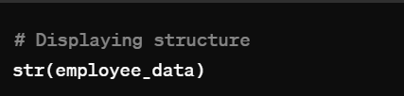
DataFrame – structure of Data

Slide 11
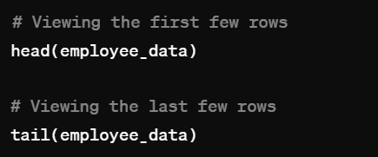
DataFrame - Head & Tail

Slide 12
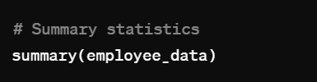
Summary statistics

Slide 13
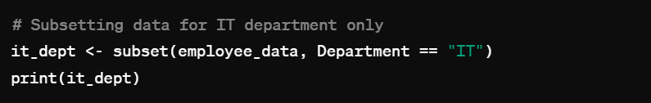
Subset dataFrame

Slide 14
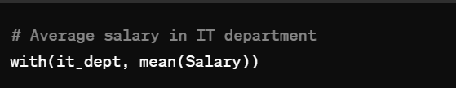
With () – Applying expression to subset

Slide 15
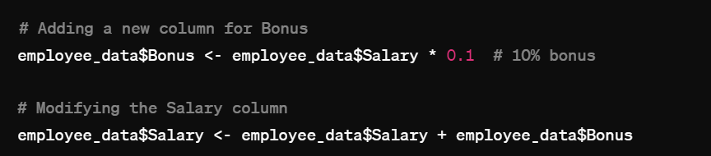
Adding & modifying columns

Slide 16
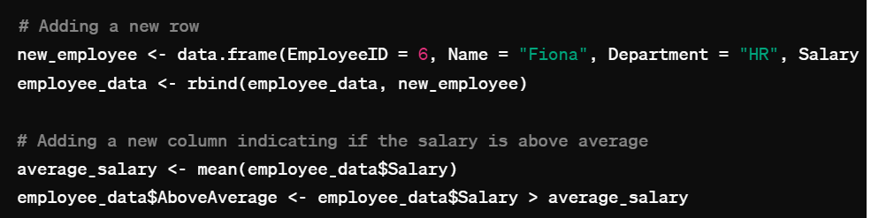
Adding Rows & Columns

Slide 17
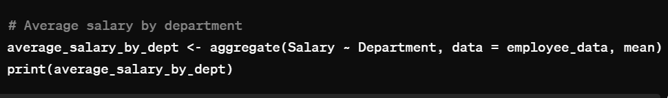
Aggregate Data

